Slide 1
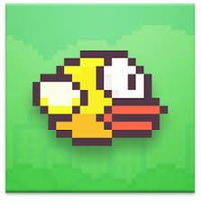
Flappy Bird
Horizon Brave - Xiaofeng Su
Yao Wei Tsai
Pengfei Liu
Zhengbang Liu

Slide 2
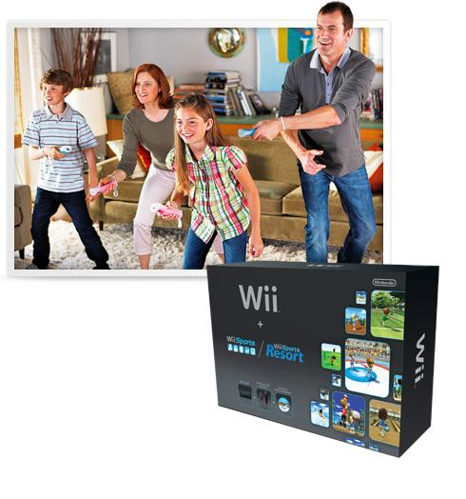
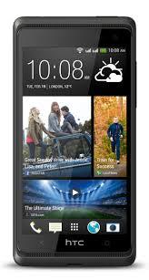
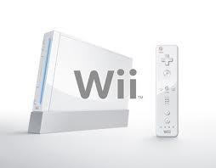
Goal and Motivation

Slide 3
Specification
•UART connection of keyboard or cellphone via Bluetooth.
•Control the bird’s position by key board or cellphone( button or shake)
•Three moving barriers with opening adjustable
•Up to two players control with cell phone and keyboard separately
•Score counting
•Pause and resume
•640*480 resolution
•Bird with animation
•Colorful background

Slide 4
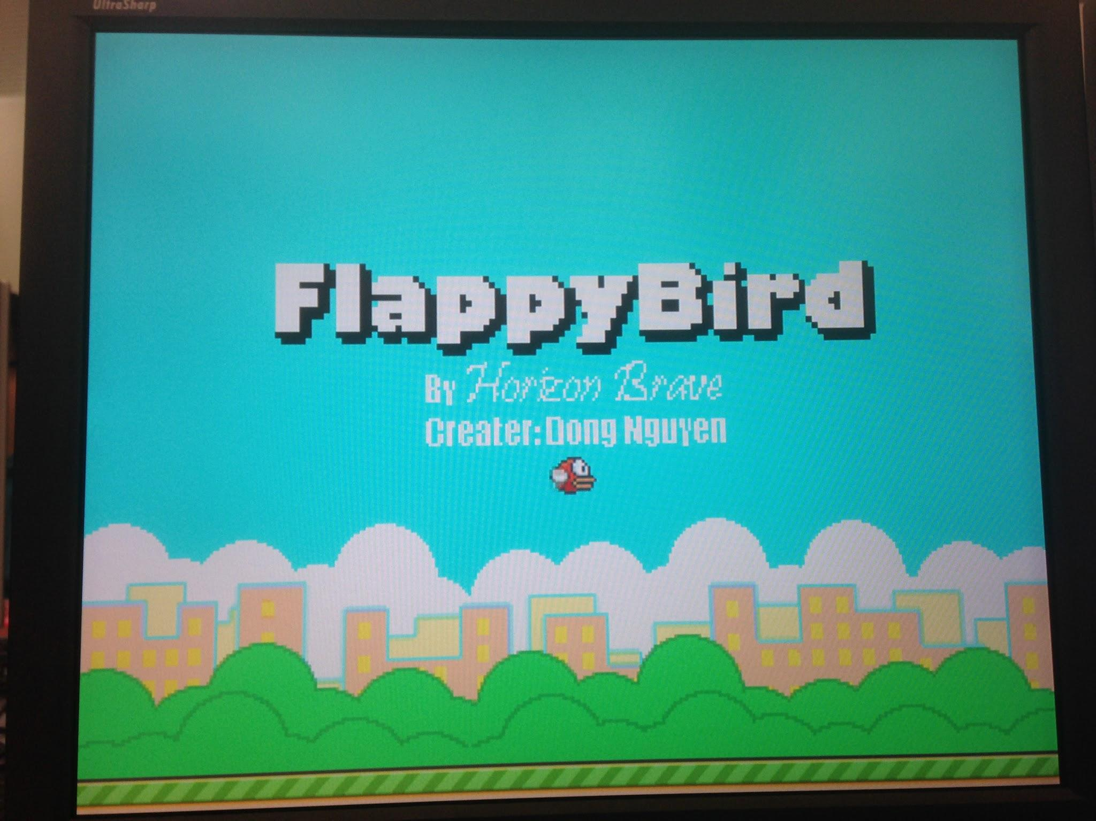
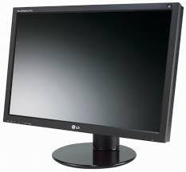
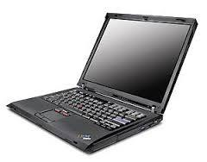
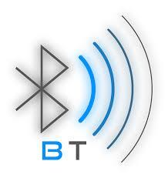
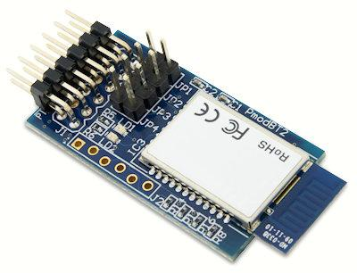
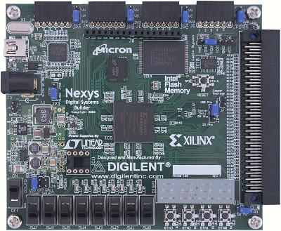
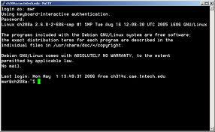
Functionality
USB_UART Cable

Slide 5
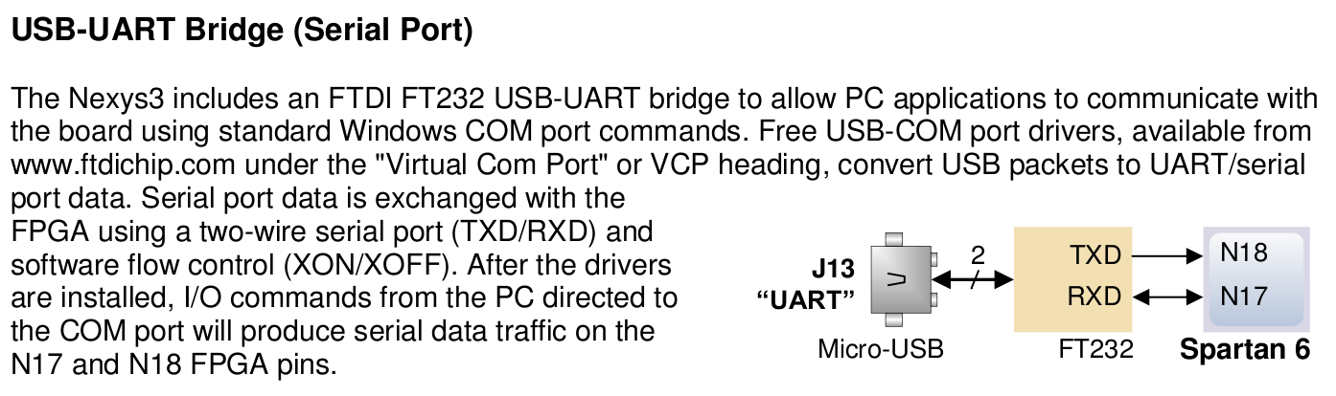
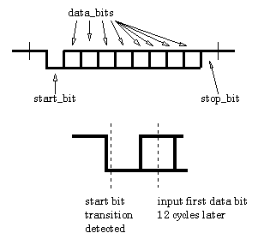
Communication
Real-Time
Baud Rate 9600HZ
(sampling at 96KHZ)

Slide 6
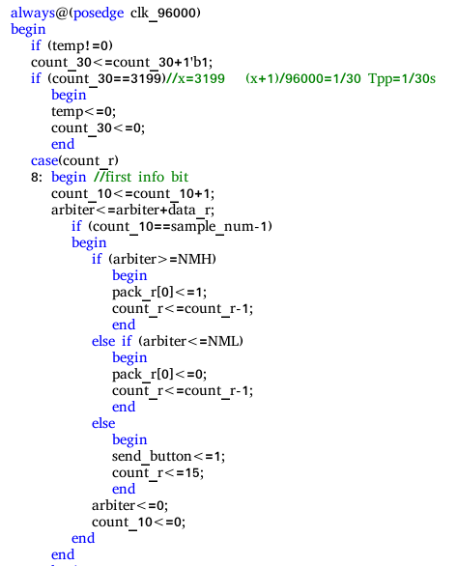

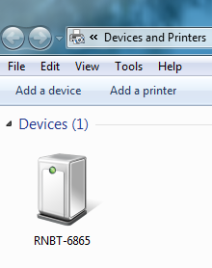
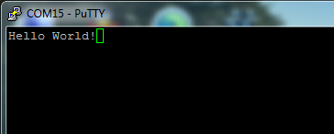
Communication
Duplexing Communication
Error Control (Parity bit)
(lag packet loss)

Slide 7
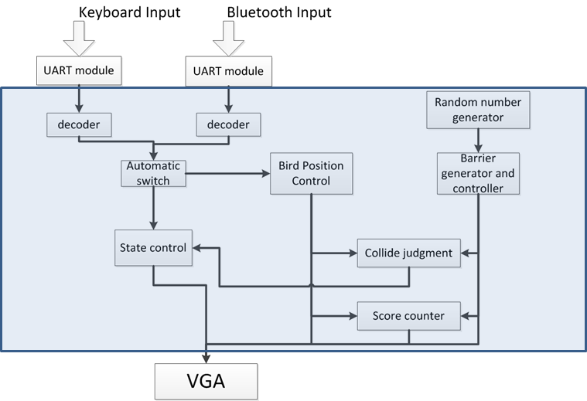
Detailed block diagrams for main logic

Slide 8
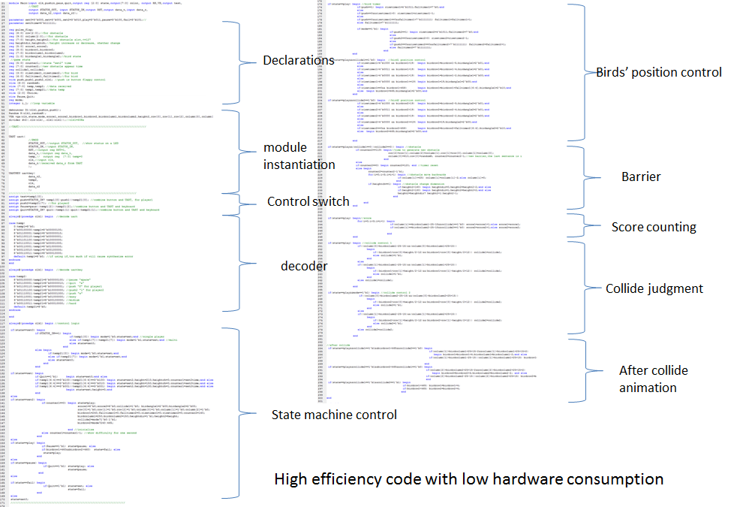

Slide 9
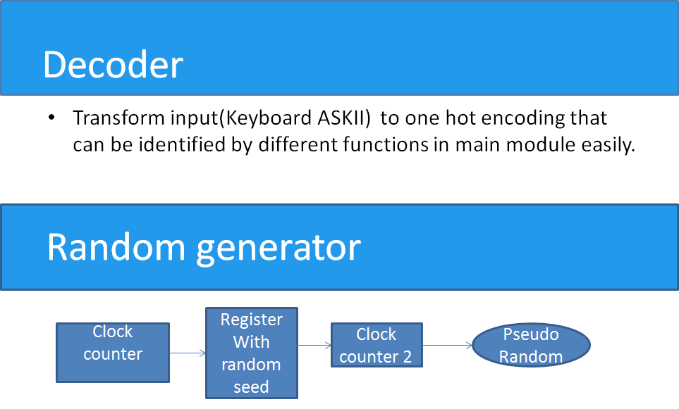

Slide 10
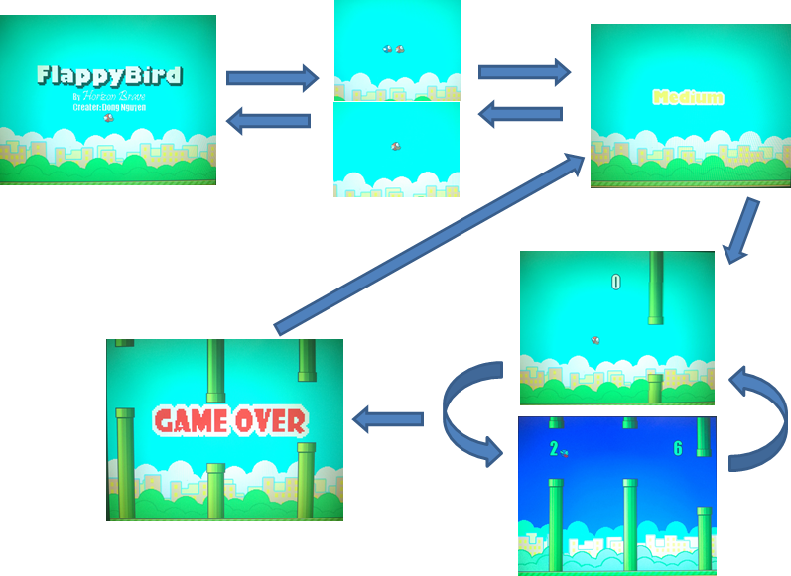
State control

Slide 11
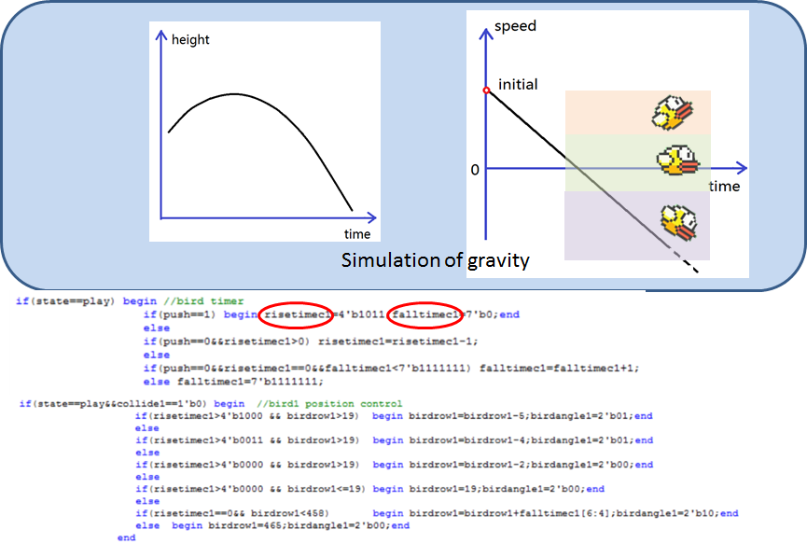
Bird position control

Slide 12
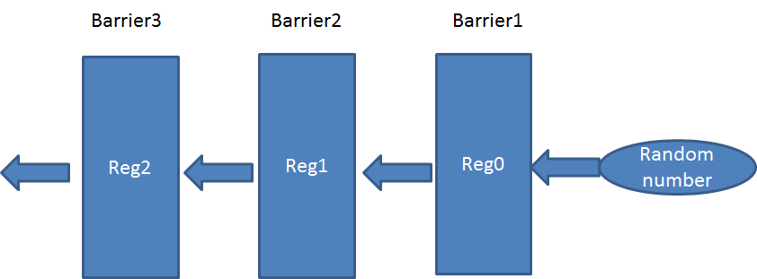
Barrier generator
Each time a new barrier is generated, contents already in the registers shift left with the oldest one discarded

Slide 13
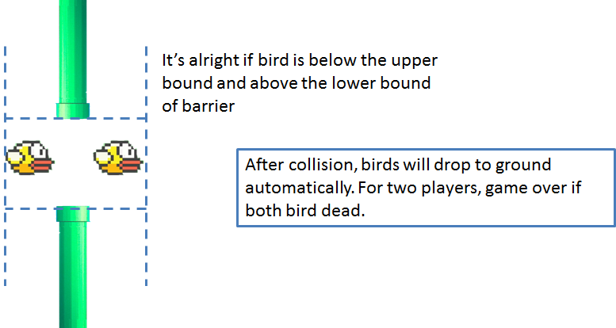
Collide judgment

Slide 14







VGA
1. Use matlab to convert image to .coe file
2. Matlab code can detect transparent pixels automatically
3. Each object has its own priority
4. Use a mux to arrange each object in different layer
5. 7 bird state of each bird(3 group)

Slide 15
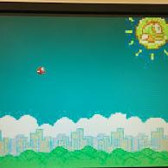
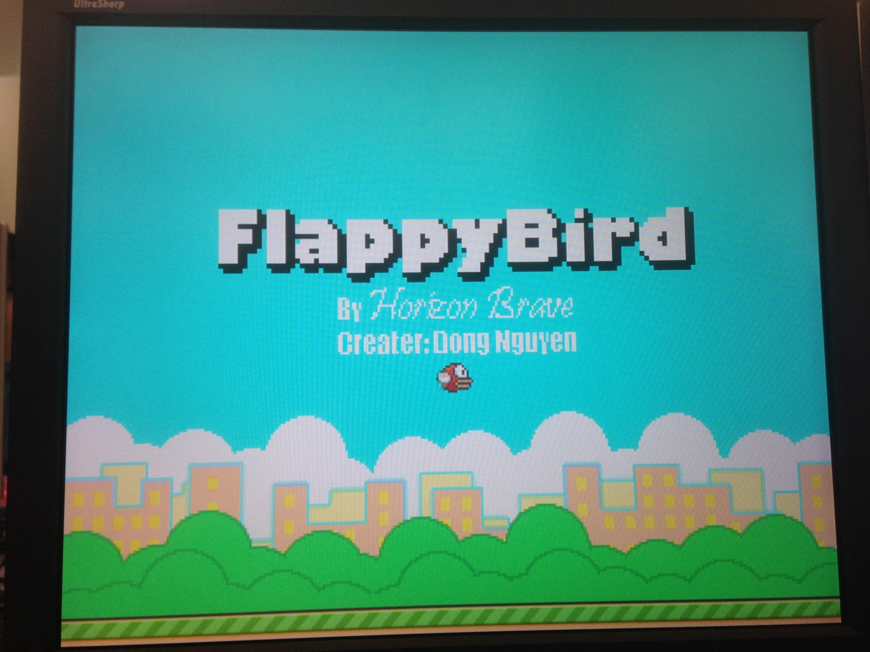
VGA
Challenge: how to HD the game(limited mem)
2 solutions: 1. compress image
2. use sd card
1st Demo
Now

Slide 16
Compress
Use indexed image
- matlab can generate Verilog code to convert the indexes to 8 bit color
- save about 1/2 the space

Slide 17
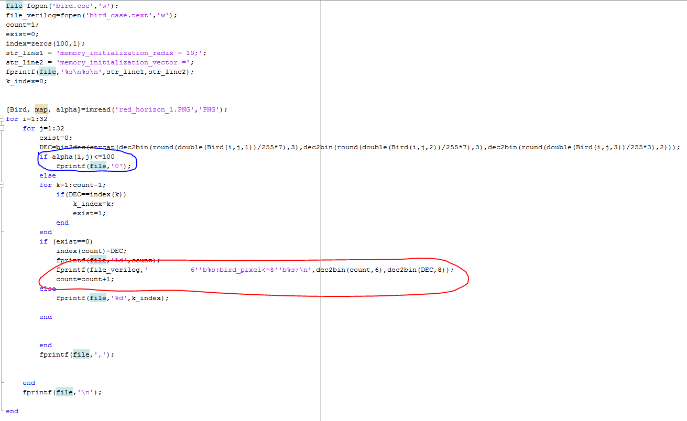
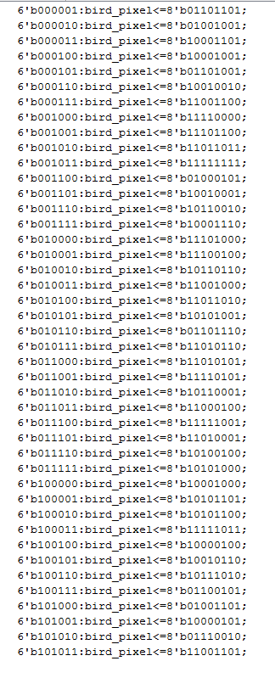
Matlab code

Slide 18

Compress
Store only area with useful information

Slide 19
Store small image
Store small image and expand it at output
- make the resolution lower, but acceptable

Slide 20
Failure:SD card
SD card transmit address via command token
Each command is at least 48 bits: not possible to read the data directly to VGA, must store the data in on board memory first
Did not get correct response from the SD card

Slide 21
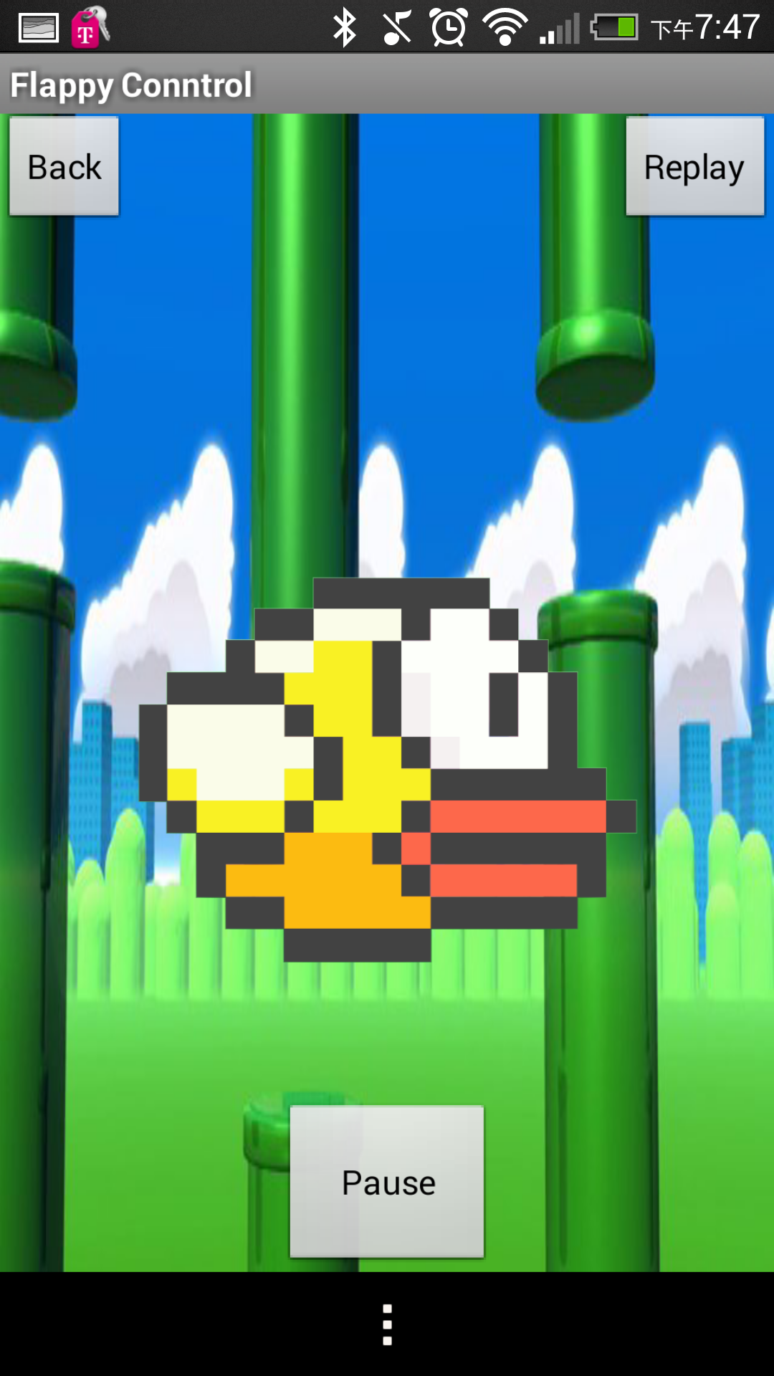
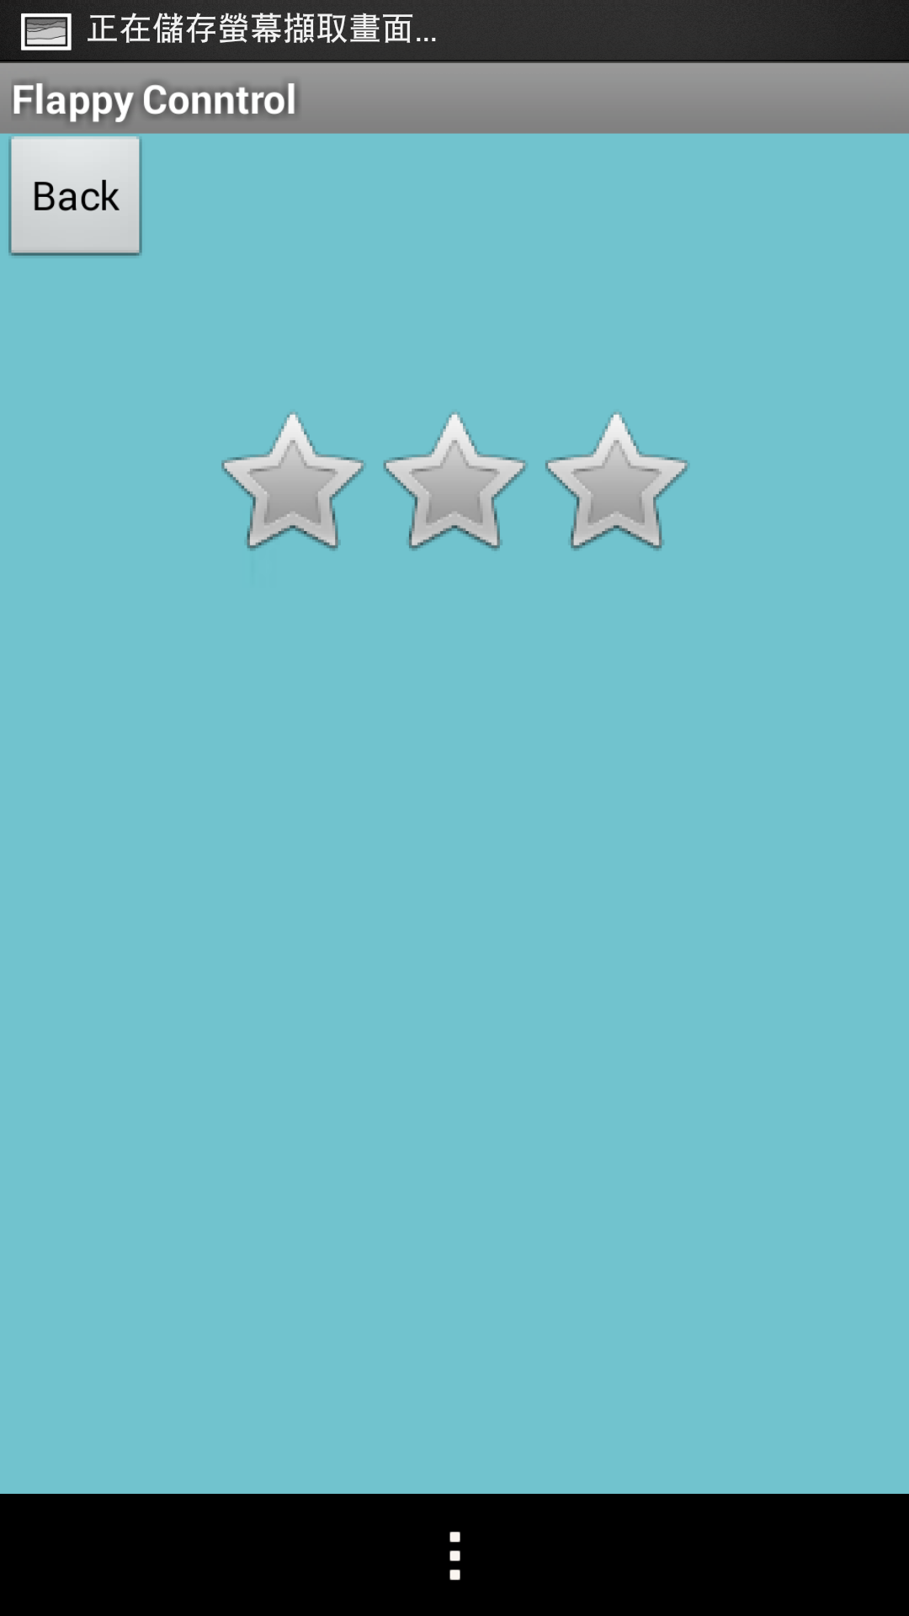
Android:
Layout and Button Implementation
OnTouchListener()
OnRatingBarChangeListener()
OnClickListener()

Slide 22
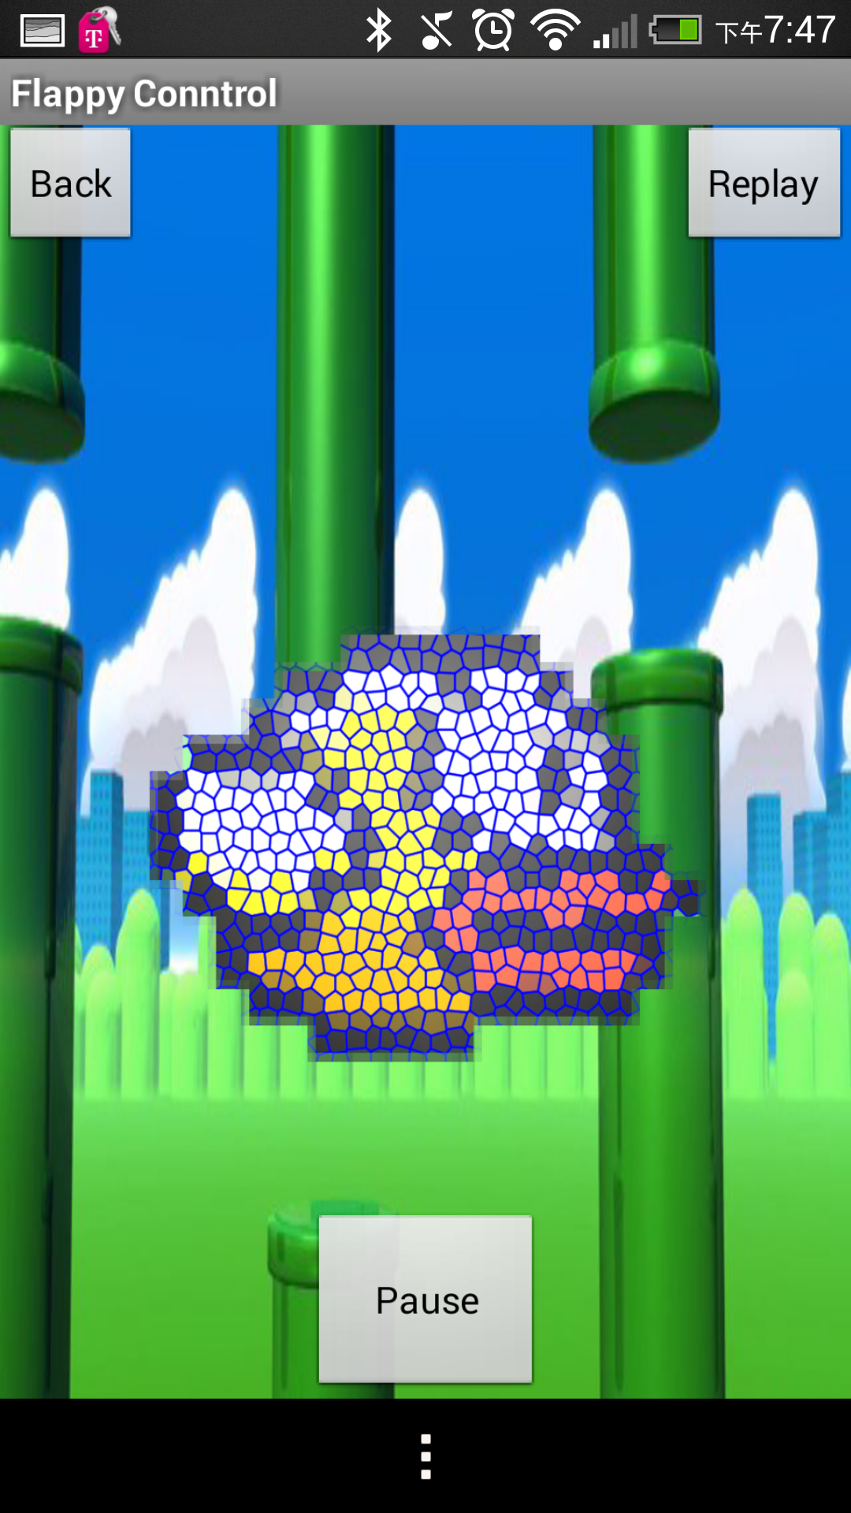
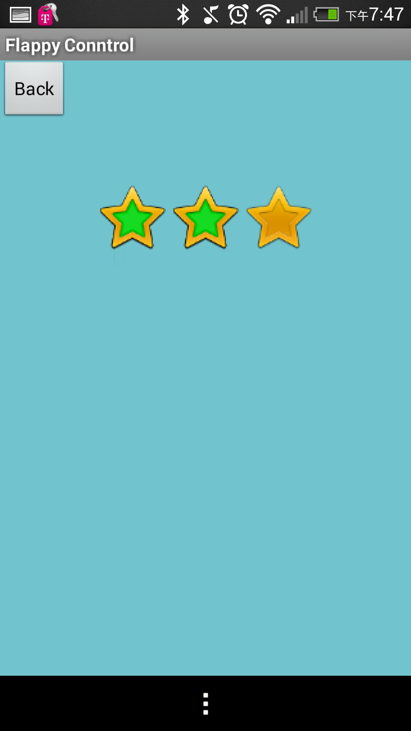
Android:
Layout and Button Implementation

Slide 23
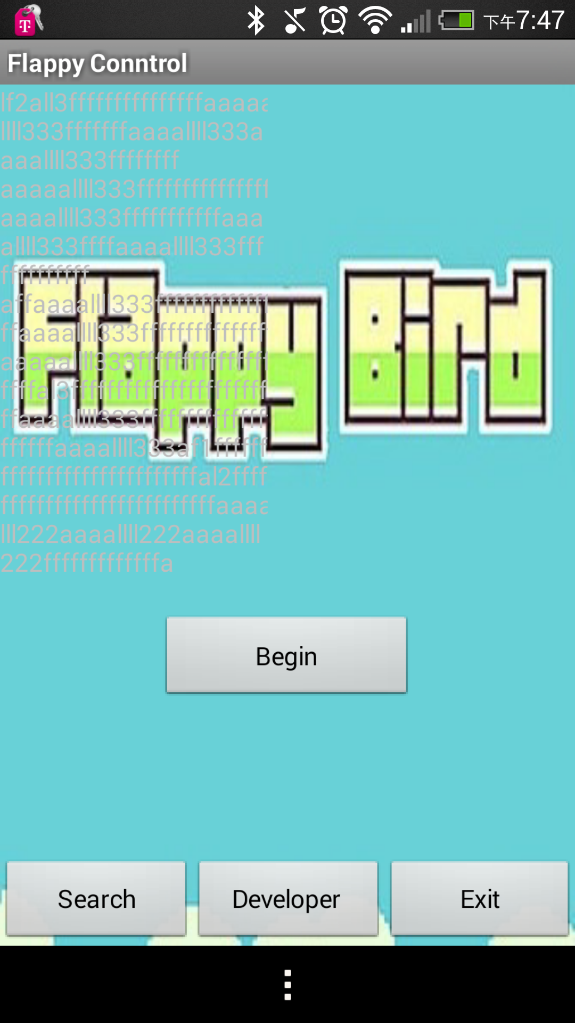
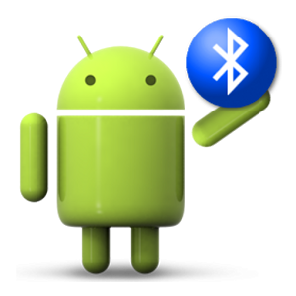
Bluetooth Connect
BluetoothAdapter
bluetooth.getRemoteDevice(address)
createRfcommSocketToServiceRecord

Slide 24
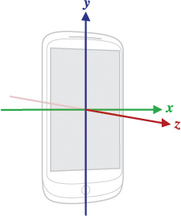
Motion Sensors : Shake
Check if the overall speed exceeds the threshold speed.

Slide 25

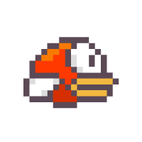
Meet Sandy and Sue
Sandy
Sue

Slide 26
Division of labor
Communication: Xiaofeng Su
Game logic: Pengfei Liu
VGA: Zhenbang Liu
Android APP: Yaowei Tsai

Slide 27
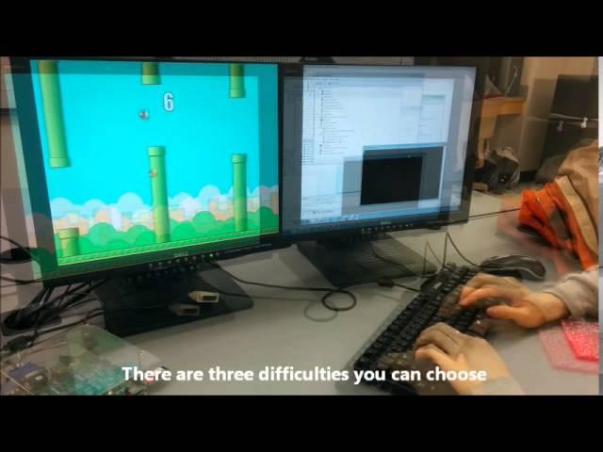
Demo & Questions

